Slide 1
MARKETING ANALYTICS MILESTONE -1
MOHAMED RIFAZ ALI
APRIL’22

Slide 2
Agenda & Executive Summary of the data
Contents of the presentation
This project aim is to find the underlying buying patterns of the
customers of an automobile part manufacturer based on the past 3
years of the Company's transaction data and hence recommend
Customized marketing strategies for different segments of customers.
Problem statement
An automobile parts manufacturing company has collected data
of transactions for 3 years. They do not have any in house data
science team, thus they have hired you as their consultant. Your
job is to use your magical data science skills to provide them with
suitable insights about their data and their customers.

Slide 3
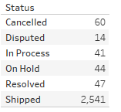
About Data
An automobile parts manufacturing company has collected data of transactions for 3 years (2018, 2019, 2020).
There are 2747 records and no duplicate or missing entries are present in the dataset.
Our job is to find the underlying buying patterns of the customers of an automobile part manufacturer and recommend customized marketing strategies for different segments of customers. So, we can consider only the order with ‘Shipped’ or ‘Resolved’ status and rest others can be ignored for our analysis.
Upon checking, we have got adequate records with 94% in
‘Shipped/Resolved’ status, which is sufficient for our analysis.

Slide 4

We can calculate the recent visit to the store by differencing the
maximum of Order date to the Order Date column.
The column deal size is based on quantity and item price (nothing but the sales). Below is the proportion of deal size
By this ‘Medium’ sized sales are high in manufacturing company.
There are 89 unique customers present in the provided dataset. One customer can have a multiple ‘order numbers’ with the quantity ordered, price of each item, order date & suggested maximum retail price.

Slide 5
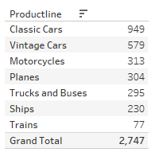
There are different product line items are present as listed below
An automobile parts of ‘cars’ are ordered in high quantities.

Slide 6
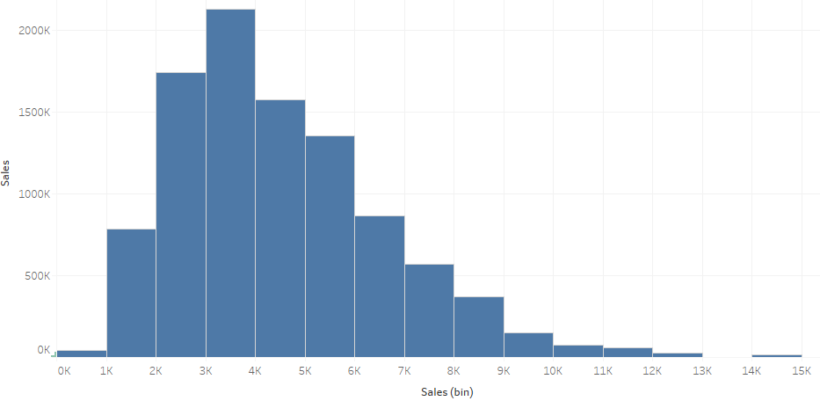
Exploratory Analysis and Inferences
Univariate
Sales data is right skewed & most of the orders placed
between 2K and 7K.

Slide 7
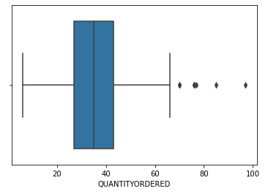
Few items has been ordered marginally high as seen below

Slide 8
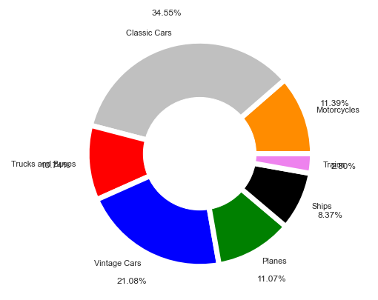
The automobile parts of a cars constitutes 55% of the ordered items,
whereas Trucks/Buses, Planes, motorcycles are around 11%, Ships
with 8% and Trains with 3%.

Slide 9
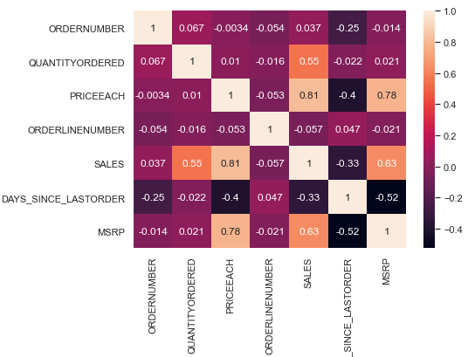
Bivariate/Multivariate
Sales is highly correlated with Quantity ordered, price of the item
and MRP.

Slide 10
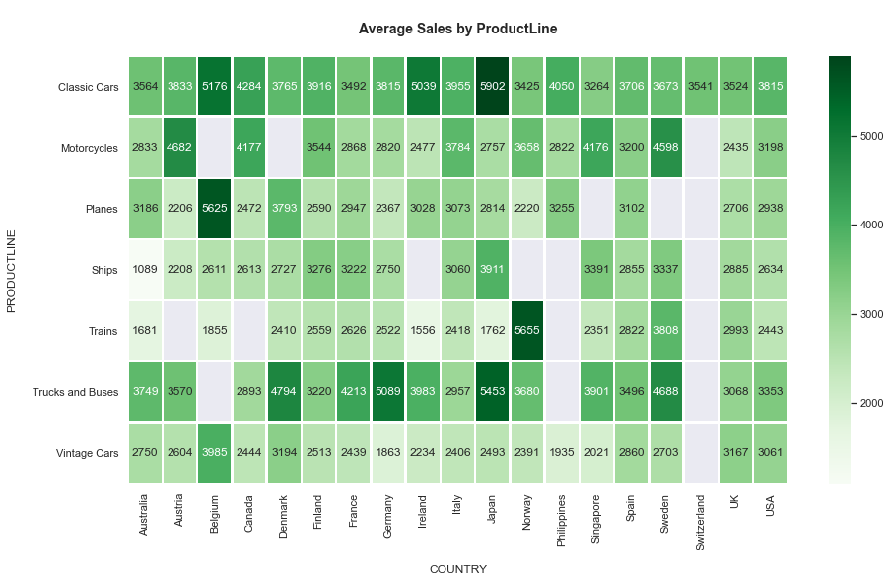

Slide 11
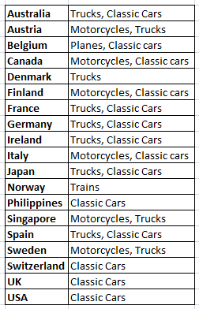
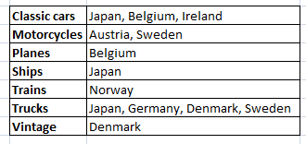
High Average Sales By Country High Average Sales by Product line

Slide 12
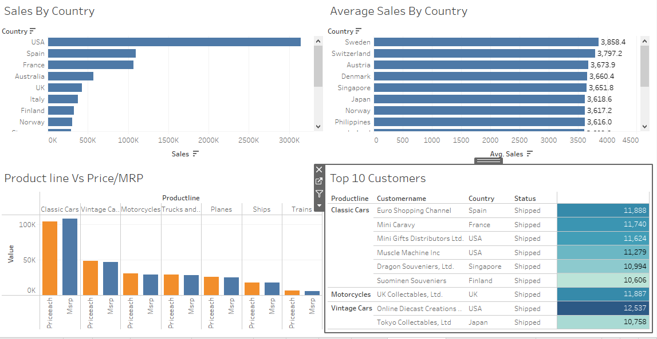
Considering only the Shipped/Resolved order status, the country USA ordered more items & its sales is quite high. However, the average sales of the cold regions such as Sweden, Switzerland, Austria is high.
For ‘Classic Cars’, price of an item is labeled little low compared to the suggested MRP.
Sales of product line Classic Cars>Vintage Cars>Motorcycles>
Trucks/Buses>Planes>Ships>Trains.

Slide 13
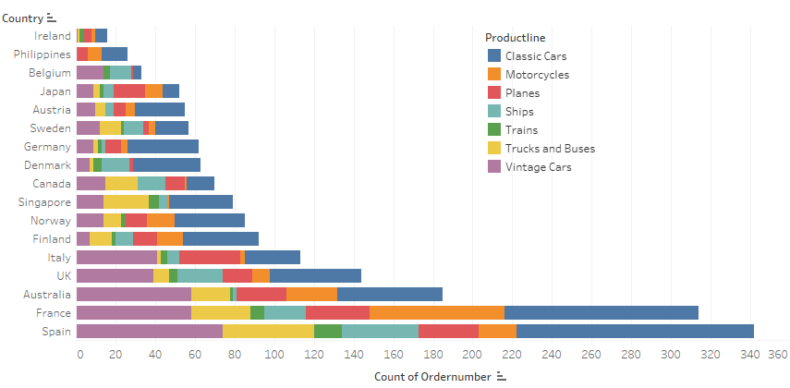
Excluding USA from the analysis, the countries such as Spain, France, Australia and UK are the countries interested in buying automobile parts from the company.
France has ordered quite good number of Motorcycle parts.
Apart from regular cars automobile parts, the countries such as Singapore, Spain, Australia and France are interested in Trucks & buses parts. Whereas, Italy, Australia, France & Spain have ordered good number of Planes parts.

Slide 14
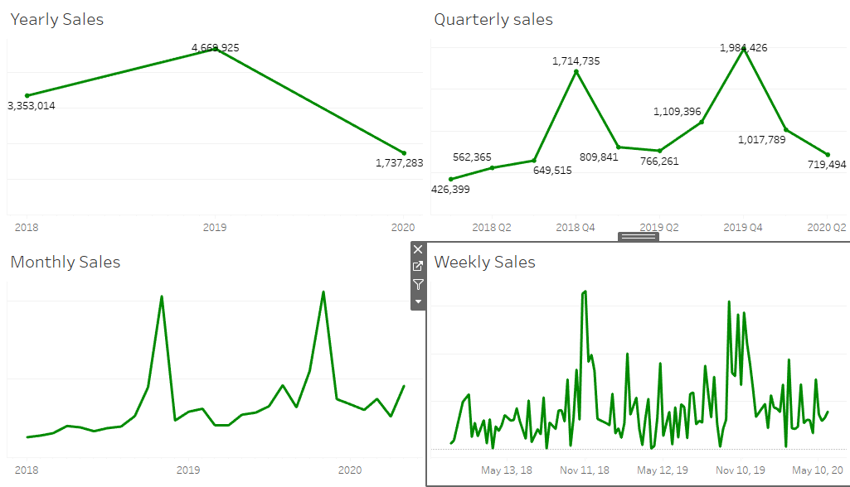
Sales is high in 2019. Seasonality is present & spike in sales beginning Q4. There is an abrupt spike during December. Otherwise sales trend is moderate across the months. It clearly indicates that increase the manufacture of automobile parts considering the holidays season.

Slide 15
Customer Segmentation using RFM analysis
What is RFM?
RFM stands for Recency (“R”), Frequency (“F”), and Monetary value (“M”). RFM represents a segmentation strategy that helps you analyze and split customers into segments based on three variables: Recency, Frequency, and Monetary Value.
The RFM model allows you to analyze historical transactional data and use this quantitative research to identify different types of customers and group them into segments based on their purchase history.
Recency. How recent was the customer's last purchase?
Frequency. How often did this customer make a purchase in a given period?
Monetary. How much money did the customer spend in a given period?

Slide 16
What all parameters used and assumptions made?
I’m using KNIME tool for the analysis & Python to cross reference.
Our job is to find the underlying buying patterns of the customers of an automobile part manufacturer and recommend customized marketing strategies for different segments of customers. So, we can consider only the order with ‘Shipped’ or ‘Resolved’ status and rest others can be ignored for our analysis. Hence, used the ‘Nominal Value Row Filter’ node to exclude the records other than Shipped/Resolved.
To calculate the recency, we subtract the maximum of Order date to the Order Date column. The recent order date is 2020-May-31. Used the Date & Time Difference node to calculate the days.
To calculate the Frequency, let’s group by the Customer Name and count the number of Order Number ( how often customer places the order).
To calculate the Monetary, it is straight forward that we can take sum of sales by Customer Name.

Slide 17
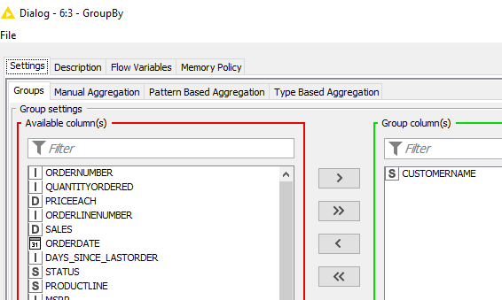
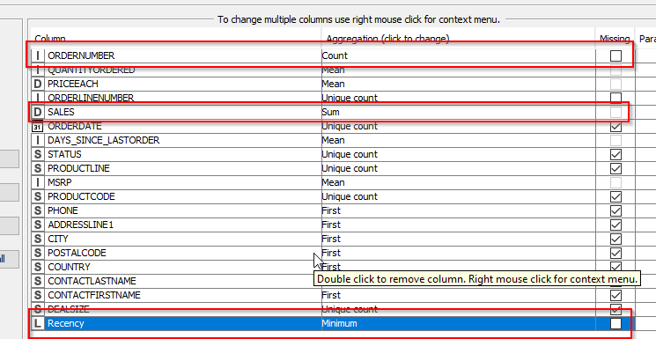

Slide 18
To segment the customer into 4 groups, used the Auto-Binner node with the quantiles as 0.0, 0.25, 0.5, 0.75, 1.0 for Recency, Frequency and Monetary fields.
Note that for Recency field, binning is reversed because recently visited customers are the valuable customers.
Using the Table creator & Cell replacer nodes, rank the customers appropriately as indicated below.
Quantiles | Frequency | Monetary | Recency
0-25% | Bin 1 | Bin 1 | Bin 4
25-50% | Bin 2 | Bin 2 | Bin 3
50-75% | Bin 3 | Bin 3 | Bin 2
75-100% | Bin 4 | Bin 4 | Bin 1
 | Frequency/Monetary | Recency
Bin 1 | Bronze | Platinum
Bin 2 | Silver | Gold
Bin 3 | Gold | Silver
Bin 4 | Platinum | Bronze

Slide 19
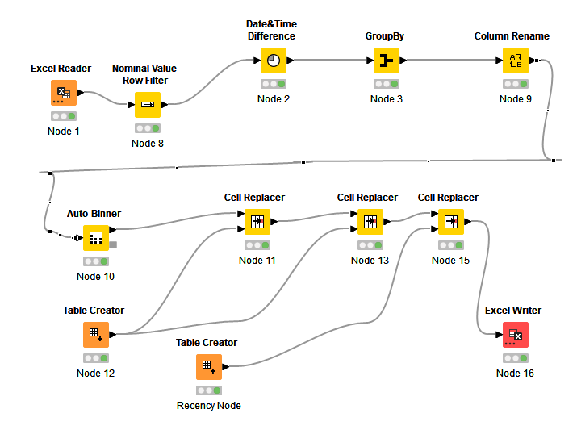
Workflow image from KNIME

Slide 20
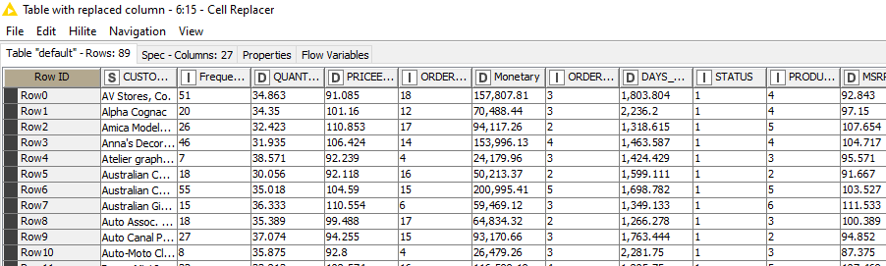
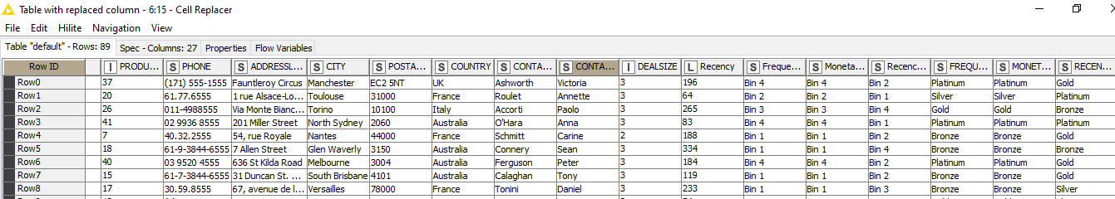
Output Table

Slide 21
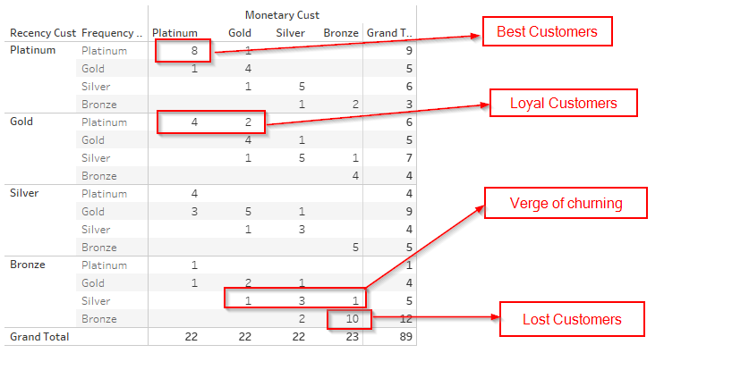
Inferences from RFM Analysis and identified segments

Slide 22
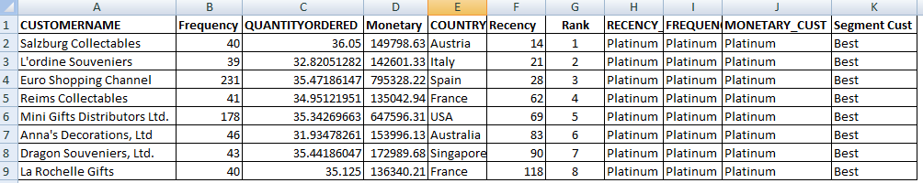
Who are your best customers? (give at least 5)
Below customers are the platinum customers, they keep visiting the stores, order placed
is often and sales is super high. We must not lose them at any cost.
Salzburg Collectables
L'ordine Souveniers
Euro Shopping Channel
Reims Collectables
Mini Gifts Distributors Ltd.
Anna's Decorations, Ltd
Dragon Souveniers, Ltd.
La Rochelle Gifts

Slide 23
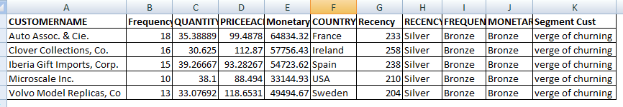
Which customers are on the verge of churning? (give at least 5)
Assuming, for our business proposal, the customer who are about to stop
visiting the store is considered as the verge of churning.
Recency – Silver ; Frequency/Monetary – Bronze
Auto Assoc. & Cie.
Clover Collections, Co.
Iberia Gift Imports, Corp.
Microscale Inc.
Volvo Model Replicas, Co

Slide 24
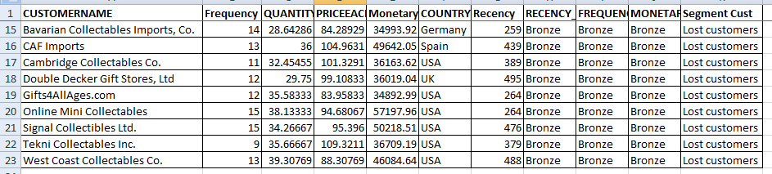
Who are your lost customers? (give at least 5)
The customers who rarely visited the stores, ordered frequency is very
low and the money spent is quite low. It is of no use to put any effort to
retain them. There are 22 customers are lost customers (Bronze).
However, I’m giving you the list from the bottom. Surprised to note
that last 5 of them are from USA.
Gifts4AllAges.com
Online Mini Collectables
Signal Collectibles Ltd.
Tekni Collectables Inc.
West Coast Collectables Co.

Slide 25
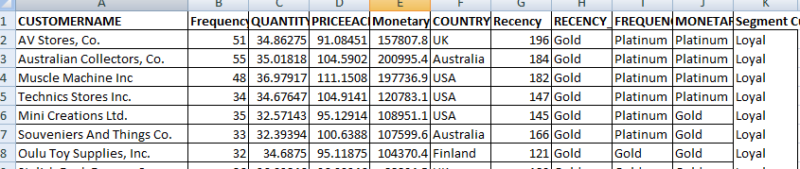
Who are your loyal customers? (give at least 5)
Assuming, the customers who less often visit to the store is considered as the
Loyal customers, but when visiting, they purchased good number of items and the
money spent is quite high. We can provide customized offers to promote them to the
best customers.
Recency – Gold ; Frequency/Monetary – Platinum/Gold
AV Stores, Co.
Australian Collectors, Co.
Muscle Machine Inc
Technics Stores Inc.
Mini Creations Ltd.

Slide 26
I’ve attached the KNIME workspace, excel, python book and
provide you here the tableau public link as well.
https://public.tableau.com/app/profile/rifaz4445/viz/Book2_16499299033650/Dashboard2?publish=yes

Slide 27
THANK YOU!

